Slide 1
Reinforcement Learning Algorithms

Slide 2
Markov Decision Process
Markov Decision Process or MDP, is used to formalize the reinforcement learning problems.
If the environment is completely observable, then its dynamic can be modeled as a Markov Process.
In MDP, the agent constantly interacts with the environment and performs actions; at each action, the environment responds and generates a new state.

Slide 3
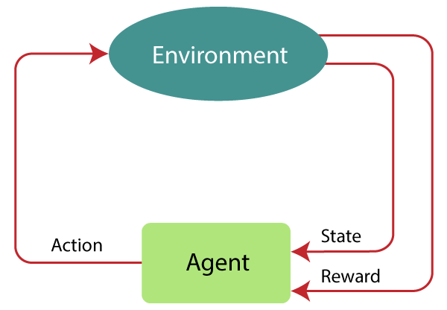

Slide 4
MDP is used to describe the environment for the RL, and almost all the RL problem can be formalized using MDP.
MDP contains a tuple of four elements (S, A, P_{a}, R_{a}):
A set of finite States S
A set of finite Actions A
Rewards received after transitioning from state S to state S', due to action a.
Probability P_{a}.
MDP uses Markov property,

Slide 5
Markov Property:
It says that "If the agent is present in the current state S1, performs an action a1 and move to the state s2, then the state transition from s1 to s2 only depends on the current state and future action and states do not depend on past actions, rewards, or states."
Or, in other words, as per Markov Property, the current state transition does not depend on any past action or state.
Hence, MDP is an RL problem that satisfies the Markov property.
Such as in a Chess game, the players only focus on the current state and do not need to remember past actions or states.

Slide 6
Markov Process:
Markov Process is a memoryless process with a sequence of random states S₁, S₂, ....., S_{t} that uses the Markov Property.
Markov process is also known as Markov chain, which is a tuple (S, P) on state S and transition function P.
These two components (S and P) can define the dynamics of the system.

Slide 7
State Action Reward State action (SARSA)
SARSA stands for State Action Reward State action, which is an on-policy temporal difference learning method.
The on-policy control method selects the action for each state while learning using a specific policy.
The goal of SARSA is to calculate the Q π (s, a) for the selected current policy π and all pairs of (s-a).
The main difference between Q-learning and SARSA algorithms is that unlike Q-learning, the maximum reward for the next state is not required for updating the Q-value in the table.

Slide 8
In SARSA, new action and reward are selected using the same policy, which has determined the original action.
The SARSA is named because it uses the quintuple Q(s, a, r, s', a’)
Where, s: original state a: Original action r: reward observed while following the states s' and a': New state, action pair.

Slide 9
SARSA Algorithm
SARSA stands for State-Action-Reward-State-Action and is a model-free, on-policy reinforcement learning method.
It works in a similar fashion to Q-learning.
The difference lies in how the reward is calculated when an action has been carried out: while Q-learning sets the reward for having carried out an action in a state based on the highest-rewarded action available within the new, resulting state, SARSA carries out an second action from the second state according to the policy it has learned and sets the reward for the first state-action pair based on what then happens.

Slide 10
The ways SARSA and Q-learning work sound very similar, and indeed the policy SARSA follows will normally be to choose the most promising available action, which would also be the highest-rewarded action in Q-learning.
However, the essential difference is that exploration means that the policy in SARSA will not always be to choose the most promising available action; it will sometimes be to choose some other action to check that the stored policy information is correct.

Slide 11
Presuming that the actions SARSA performs when exploring are confirmed as being less optimal than the ones specified by its existing policy, SARSA – unlike Q-learning – is able to take into account how much less optimal they are, preferring alternative options that are only slightly sub-optimal to alternative options that turn out to be catastrophic.
In a classic example, a mouse actor learning to walk down a virtual cliff towards some cheese will learn to walk down the cliff edge (the shortest path) if Q-learning is used; with SARSA, on the other hand, the mouse will learn move away from the edge when walking so that a single move in the wrong direction does not lead to death on the rocks below.

Slide 12
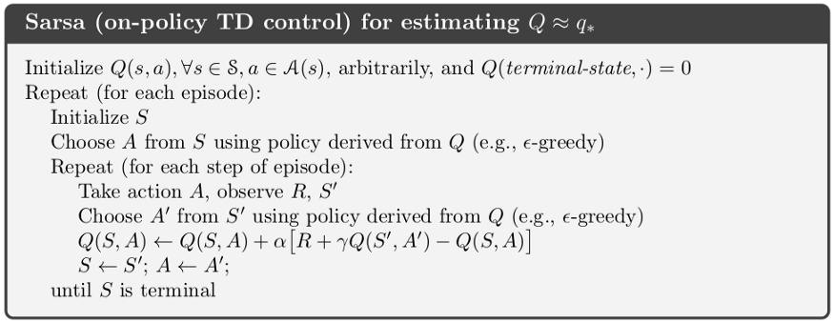
SARSA Algorithm

Slide 13
Q-Learning
Q-learning is an Off policy RL algorithm, which is used for the temporal difference Learning. The temporal difference learning methods are the way of comparing temporally successive predictions.
It learns the value function Q (S, a), which means how good to take action "a" at a particular state "s."
The below flowchart explains the working of Q- learning:

Slide 14
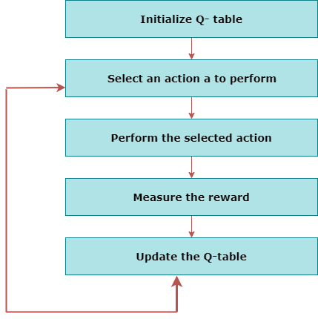

Slide 15
Deep Q Neural Network (DQN):
As the name suggests, DQN is a Q-learning using Neural networks.
For a big state space environment, it will be a challenging and complex task to define and update a Q-table.
To solve such an issue, we can use a DQN algorithm.
Where, instead of defining a Q-table, neural network approximates the Q-values for each action and state.

